Slide 1
Lesson 8 – Functional Programming

Slide 2
Lesson goals
Functional programming
Functional interface
Lambda’s

Slide 3
Functional programming paradigm
It is a style of building the structure and elements of computer programs — that treats computation as the evaluation of mathematical functions and avoids changing-state and mutable data
In functional code, the output value of a function depends only on the arguments that are input to the function.
Note. If we call function with the same arguments, it always returns the same result

Slide 4
Lambda
Lambda – a piece of code
Anonymous class
Runnable r1 = new Runnable() {
@Override
public void run() {
System.out.print(“Hello");
}
};
Lambda
Runnable r2 = () -> {
System.out.print(“Hello");
};

Slide 5
Lambda
Lambda expressions let you express instances of single-method classes more compactly.
Recall that lambda expressions rely on the notion of deferred execution.

Slide 6
Lambda
Lambda expressions let you express instances of single-method classes more compactly.
Recall that lambda expressions rely on the notion of deferred execution.

Slide 7
Functional interface
has exactly one abstract method
can contain unlimited count of default methods
can contain unlimited count of static methods
can contain unlimited count of private methods
can re-declare Object methods

Slide 8
Functional interface
@FunctionalInterface interface Speakable { String say(); }

Slide 9
Functional interface
@FunctionalInterface interface Speakable { String say();
int hashCode(); // redeclare Object method static void someStatic() { System.out.println("In static..."); }
default void someDefault() { System.out.println("In default..."); }
private void somePrivate() { System.out.println("In private..."); } }

Slide 10
Lambda
parameter name
body
(Task val) -> {return val.execute();}
optional parameter type
required because in block
arrow

Slide 11
Lambda
A lambda expression is like a method: it provides a list of formal parameters and body
s -> s.length()
(int a, int b) -> a + b
() -> 42
(x, y, z) -> {
if (x) {
return y;
} else {
return z;
}
}
Return is implicit and can be omitted
A lambda body is either a
single expression or a block

Slide 12
Lambda and Anonymous class difference
this keyword behavior is different
For an anonymous class, this keyword resolves to the anonymous class itself. For a lambda expression - class where the lambda is written.
Default methods accessibility
Default methods of a functional interface cannot be accessed from within lambda expressions. Anonymous classes can.
Different compiled bytecode
Anonymous classes are compiled into inner classes. Lambda expressions are converted into private static (in some cases) methods of their enclosing class and, using the invoke dynamic instruction.

Slide 13
Lambda declaration
Lambda expressions don't contain the information about which functional interface are implementing.
interface Searchable { boolean test(Car car); }
interface Saleable { boolean approve(Car car); } Searchable s1 = c -> c.getCostUSD() > 20000; Saleable s2 = c -> c.getCostUSD() > 20000;

Slide 14
Lambda vs Anonymous class
@FunctionalInterface interface Translator { String translate(String input); }
public static void main(String[] args) { Translator oldSchool = new Translator() { @Override public String translate(String input) { return input.toLowerCase(); } }; Translator newSchool = input -> input.toLowerCase(); Translator newerSchool = String::toLowerCase; }

Slide 15
Accessibility
Lambda expressions can access
static variables
instance variables
effectively final method parameters
effectively final local variables
does not allow checked exceptions (if not declared)

Slide 16
Method reference
Sometimes, however, a lambda expression does nothing but call an existing method. In those cases, it's often clearer to refer to the existing method by name.
A method reference is the shorthand syntax to a lambda expression that executes just one method.

Slide 17
Method reference
@FunctionalInterface public interface Comparator<T> { int compare(T o1, T o2); } public static class Person { private LocalDate birthday; public static int compareByAge(Person a, Person b) { return a.birthday.compareTo(b.birthday); } } public static void main(String[] args) { Person[] people = {new Person(), new Person()}; Arrays.sort(people, (a, b) -> Person.compareByAge(a, b)); // lambda Arrays.sort(people, Person::compareByAge); // method reference }

Slide 18
Method reference
Reference to a static method
ContainingClass::staticMethodName
Reference to an instance method of a particular object
containingObject::instanceMethodName
Reference to an instance method of an arbitrary object of a particular type
ContainingType::methodName
Reference to a constructor
ClassName::new

Slide 19
Static method reference
class Numbers { public static boolean isMoreThanFifty(int num) { return num > 50; } public static List<Integer> findNumbers( List<Integer> integers,
Predicate<Integer> predicate
) { List<Integer> newList = new ArrayList<>(); for (Integer i : l) { if (p.test(i)) { newList.add(i); } } return newList; } }

Slide 20
Static method reference
List<Integer> list = Arrays.asList(12, 5, 55, 68, 40); // Using an anonymous class findNumbers(list, new Predicate<Integer>() { public boolean test(Integer i) { return Numbers.isMoreThanFifty(i); } }); // Using a lambda expression findNumbers(list, (i) -> Numbers.isMoreThanFifty(i)); // Using a method reference findNumbers(list, Numbers::isMoreThanFifty);

Slide 21
Reference instance method of an object
class Mechanic { void fix(Car c) {…} }
class Car { int id; //... }
public static void main(String[] args) { Mechanic mechanic = new Mechanic(); Car car = new Car(); // Using an anonymous class execute(car, new Consumer<Car>() { public void accept(Car c) { mechanic.fix(c); } }); // Using a lambda expression execute(car, c -> mechanic.fix(c)); // Using a method reference execute(car, mechanic::fix); } static void execute(Car car, Consumer<Car> c) { c.accept(car); }

Slide 22
Instance method of object of a particular type
class Shipment { double calculateWeight() {…} }
public static void main(String[] args) { List<Shipment> l = new ArrayList<>();
// Using an anonymous class calc(l, new Function<Shipment, Double>() { public Double apply(Shipment s) { // The object return s.calculateWeight(); // The method } });
// Using a lambda expression calc(l, s -> s.calculateWeight());
// Using a method reference calc(l, Shipment::calculateWeight); } static List<Double> calc(List<Shipment> l, Function<Shipment, Double> f) { List<Double> results = new ArrayList<>(); l.forEach(s -> results.add(f.apply(s))); return results; }

Slide 23
Reference to a constructor
// Using an anonymous class Supplier<List<String>> s = new Supplier() { public List<String> get() { return new ArrayList<String>(); } }; List<String> l = s.get();
// Using a lambda expression Supplier<List<String>> s = () -> new ArrayList<String>(); List<String> l = s.get();
// Using a method reference Supplier<List<String>> s = ArrayList::new; List<String> l = s.get();

Slide 24
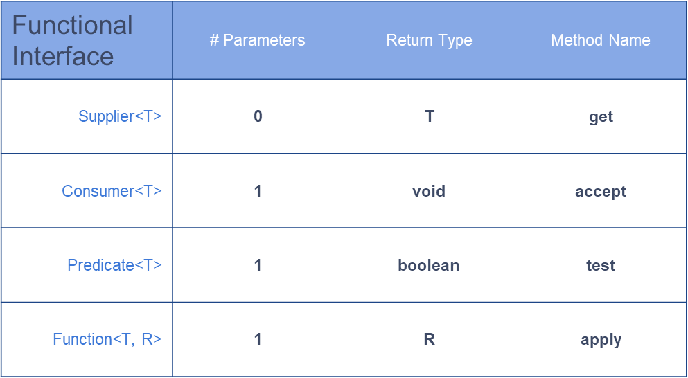
Common functional interfaces

Slide 25
Supplier
@FunctionalInterface interface Supplier<T> { T get(); }
class Car { //... }
public static void main(String[] args) { Supplier<Car> suppl1 = () -> new Car(); Supplier<Car> suppl2 = Car::new; Supplier<Car> suppl3 = new Supplier<Car>() { @Override public Car get() { return new Car(); } };
println(suppl1.get()); //Car@26275bef println(suppl1.get()); //Car@7690781 println(suppl2.get()); //Car@77eca502 println(suppl2.get()); //Car@3246fb96 println(suppl3.get()); //Car@2e222612 println(suppl3.get()); //Car@61386958 println(suppl1);//Main$$Lambda$76/0x000000080012d840@73ee04c8 println(suppl2);//Main$$Lambda$77/0x000000080012dc40@7671cb68 println(suppl3);//Main$1@49dc7102 }

Slide 26
Consumer
@FunctionalInterface interface Consumer<T> { void accept(T t); }
class Car { //... }
public static void main(String[] args) { Supplier<Car> supplier1 = () -> new Car(); Supplier<Car> supplier2 = Car::new;
Consumer<Car> consumer1 = System.out::println; Consumer<Car> consumer2 = car -> System.out.print(car); consumer1.accept(supplier1.get()); //Car@14c966a consumer1.accept(supplier2.get()); //Car@14d3709 consumer2.accept(supplier1.get()); //Car@50df2e consumer2.accept(supplier2.get()); //Car@181eb93 }

Slide 27
Predicate
@FunctionalInterface interface Predicate<T> { boolean test(T t); }
class Car { //... boolean isElectric() { return false; } }
public static void main(String[] args) { Predicate<Car> predicate1 = car -> car.isElectric(); Predicate<Car> predicate2 = Car::isElectric; Supplier<Car> supplier = Car::new;
println(predicate1.test(supplier.get()));//false
println(predicate2.test(supplier.get()));//false }

Slide 28
Function
@FunctionalInterface interface Function<T, R> { R apply(T t); }
class Berry { //... }
class Jam { Jam(Berry berry) { // magic } }
public static void main(String[] args) {
Function<Berry,Jam> factory1 = Jam::new; Function<Berry,Jam> factory2 = berry -> new Jam(berry); println(factory1.apply(new Berry())); //Jam@1eba861 println(factory2.apply(new Berry())); //Jam@1480cf9 }

Slide 29
Homework
Implement Caesar, Morse, Vigenere encoders using
lambda
method reference
Implement Caesar, Morse, Vigenere decoders using
lambda
method reference

Slide 30
Links
Lambda Expressions
Lambda Expressions
Lambda QuickStart
Method Reference Expressions
Lambda's (habrahabr)
Lambda's best practices

Slide 31
Thanks!
Any Questions?
Or find us in Slack:
@Yaroslav Brahinets
@Vasya Rudas
@Oleksandr Kucher

